Slide 1

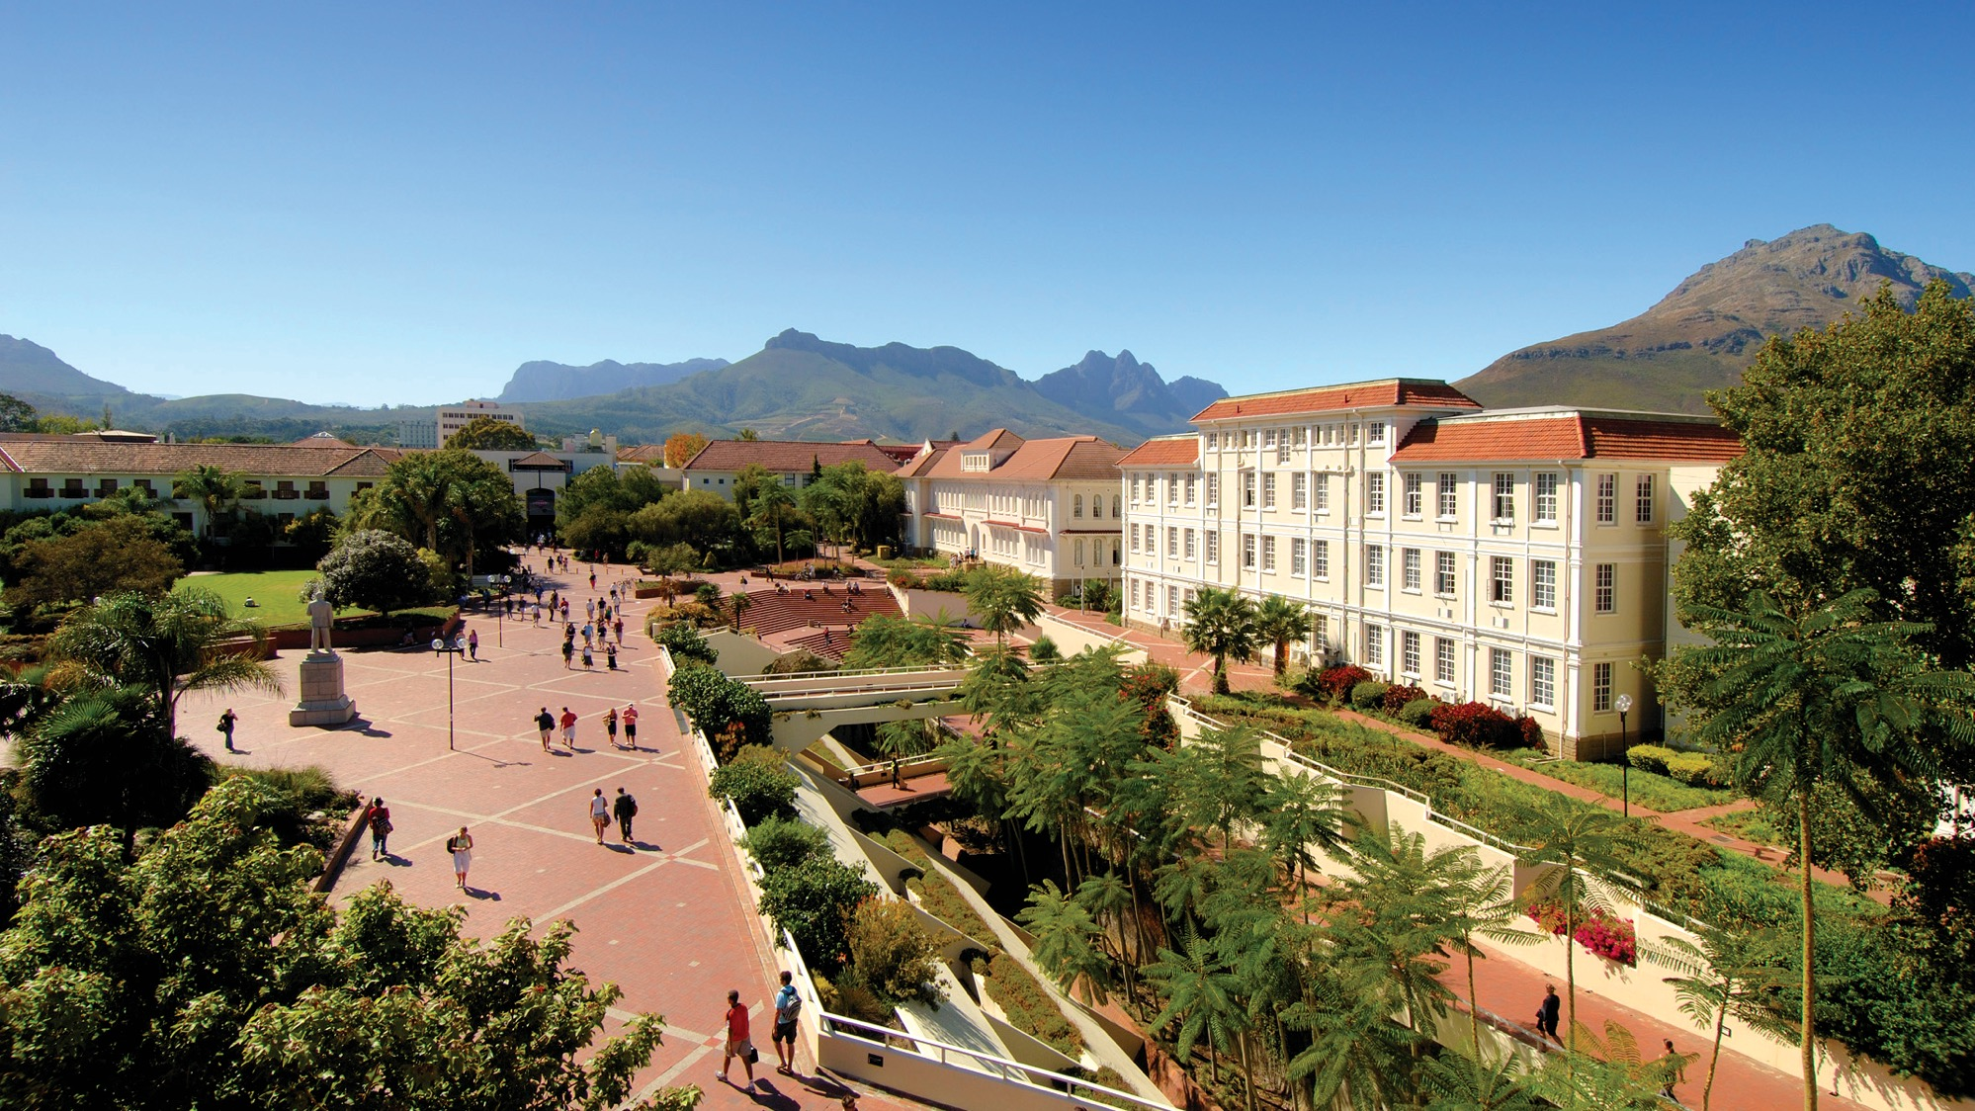
Why the only sustainable economy for rooibos and honeybush is green
Dr Rhoda Malgas
Department of Conservation Ecology and Entomology
Stellenbosch University
South Africa
African Biotrade Conference: Sandton, Johannesburg
15 September 2023
Photo by Stefan Els
Notes:
Cover/End Slide Layout
The maroon rectangle and ghost text placeholder is fully scalable and movable, as is the SU logo.
To change the image:
Select it, then click on the Picture Format tab.
Click on the Change Picture icon and choose the From a File option .
Browse and select a picture and click on the Insert button.
Use the Crop command to adjust the image.
Click on the Crop command again to apply the changes.
Remember to add image attributions to photographs or artworks.

Slide 2
Rooibos and honeybush are relatives, so they are ecologically similar.
Fabaceae
Aspalathus
A. linearis
Cyclopia
C. subternata
Family
Genus
Species
Ecotypes
C. intermedia
C. genistoides
Local harvesters distinguish species with local names.
Local plant names reflect differences in plant ecology
Ecotypes = habitats
Veldtee
Vleitee
Bergtee
Kustee

Slide 3
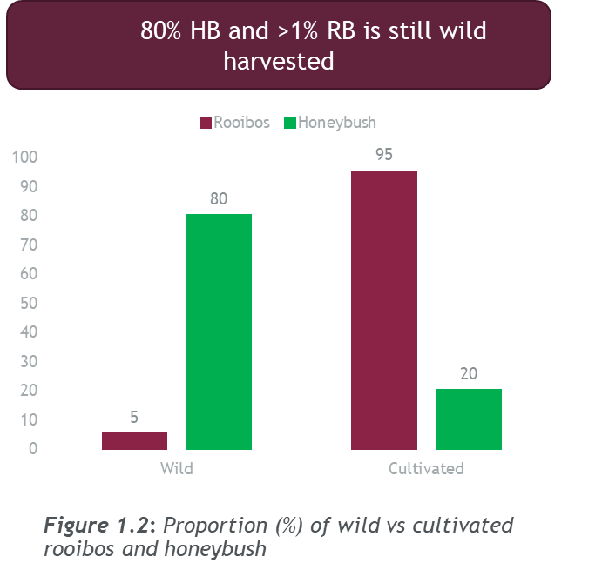
Wild rooibos and honeybush are relatives of cultivated plants traded in international markets.
Wild plant habitats are important for cultivation.
Looking after the natural environment supports wild plants.

Slide 4
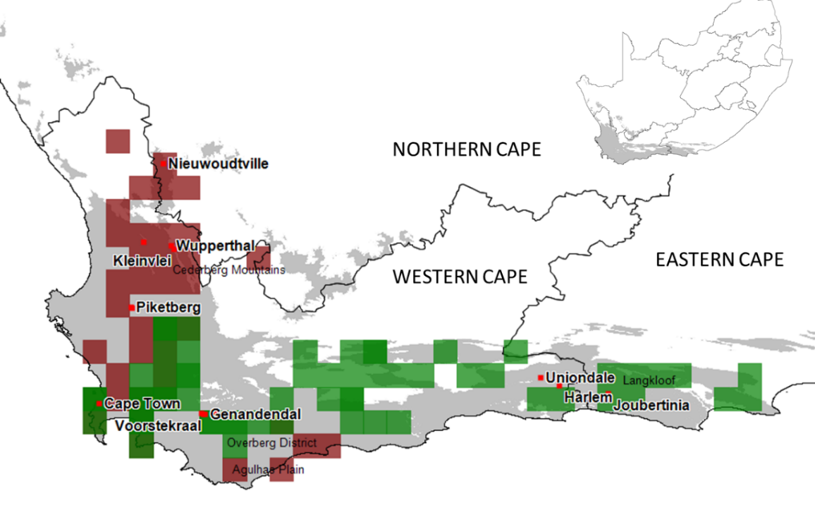
Fynbos – the home of rooibos and honeybush tea, unique to South Africa
Size of CFR = 90 000 km²
No. plant species = 9 500
Endemism = 70%
Most mega-diverse of 6 Mediterranean Type Ecosystems in the World.
Hot, dry summers; cold, wet winters
Poor-nutrient, high pH sandstone soils (low in N and P)
Fire as a natural disturbance (10-25 year cycles)
Cape Fynbos
Rooibos
Honeybush
Notes:
To change or delete the Faculty Name, go to:
View > Slide Master
Edit the text on the very top slide and close the Slide Master by clicking on the X icon “Close Master”.
Delete the slides or ghost placeholders you do not wish to include in your presentation.

Slide 5
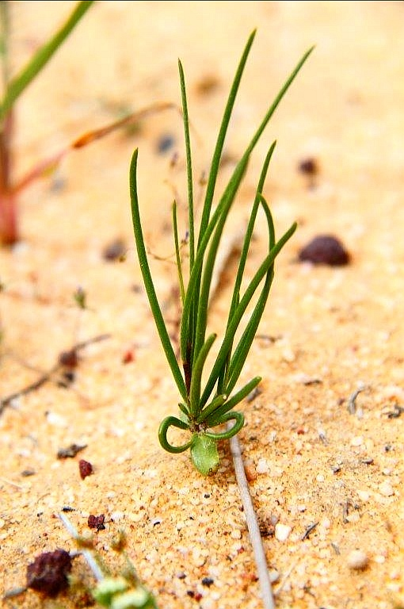
Rooibos (Aspalathus linearis) and Honeybush (Cyclopia spp.) - ecophysiological adaptations
Limit transpiration with rolled leaves, sunken stomata
Dormancy to conserve energy during wet, cold winter months.
Reseed – regeneration from seed
Form symbiotic relationships for N-fixation
P acquisition with cluster roots
Resprout – lignotuber development
Quick precipitation uptake with adventitious roots close to surface
Tap into subsurface water with a long taproot
Notes:
To change or delete the Faculty Name, go to:
View > Slide Master
Edit the text on the very top slide and close the Slide Master by clicking on the X icon “Close Master”.
Delete the slides or ghost placeholders you do not wish to include in your presentation.

Slide 6
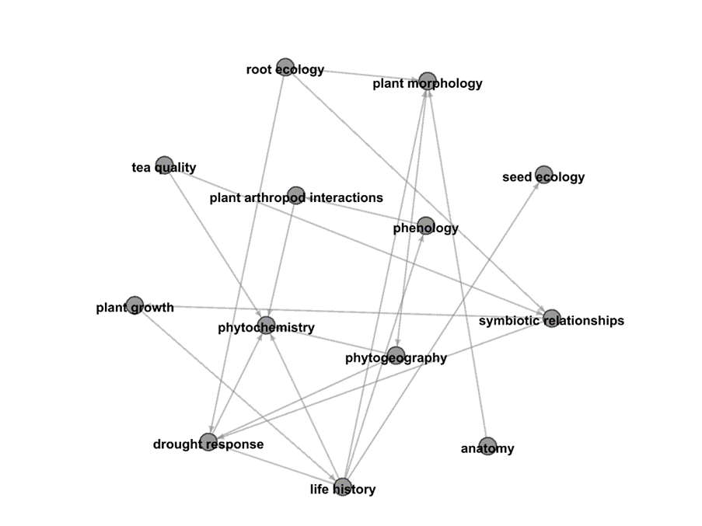
Ecophysiological characteristics drive plant growth, health and tea quality… and harvest sustainability!
Wild rooibos lignotuber

Slide 7
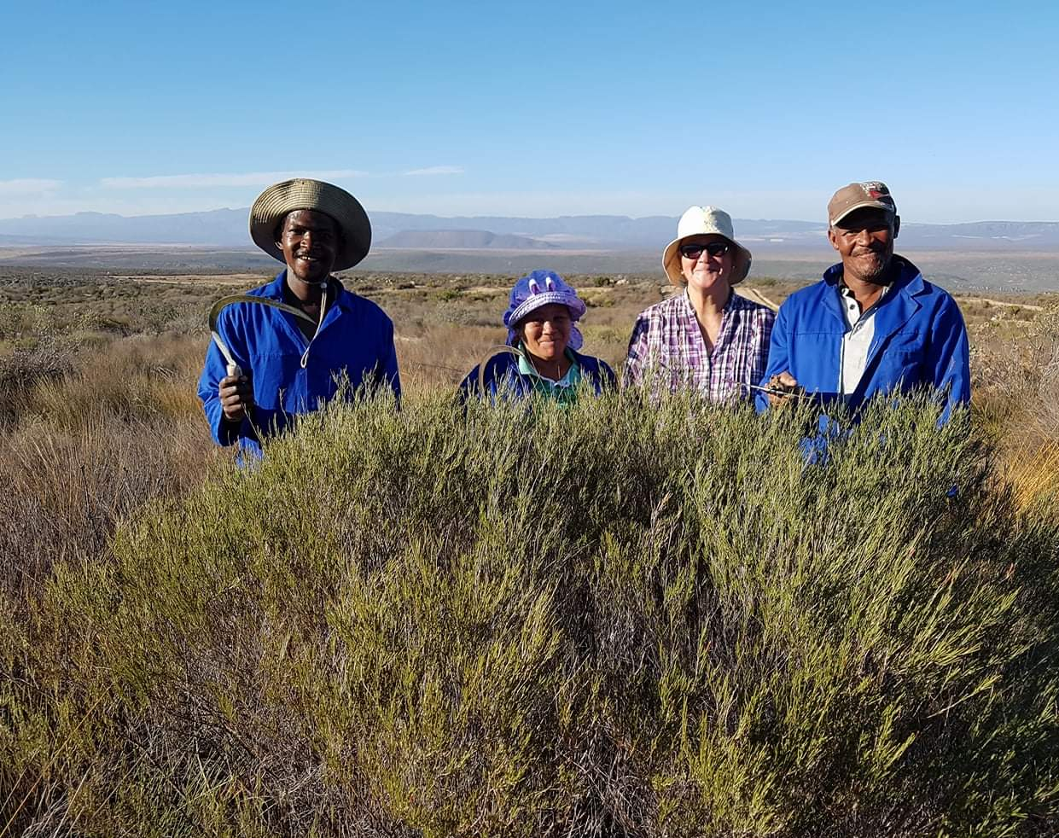
What does “sustainability” mean for Fynbos sectors?
Sustainability is posited as outcomes in wild-harvesting and agricultural production of rooibos and honeybush that:
ensure the ecological integrity of production landscapes;
enhance the dignity and collective choice action of all local actors, and
sustain livelihood options of the harvesters directly dependent on the resource; they are the custodians, knowledge-bearers, and their families directly dependent on the resource.
Notes:
To change or delete the Faculty Name, go to:
View > Slide Master
Edit the text on the very top slide and close the Slide Master by clicking on the X icon “Close Master”.
Delete the slides or ghost placeholders you do not wish to include in your presentation.

Slide 8
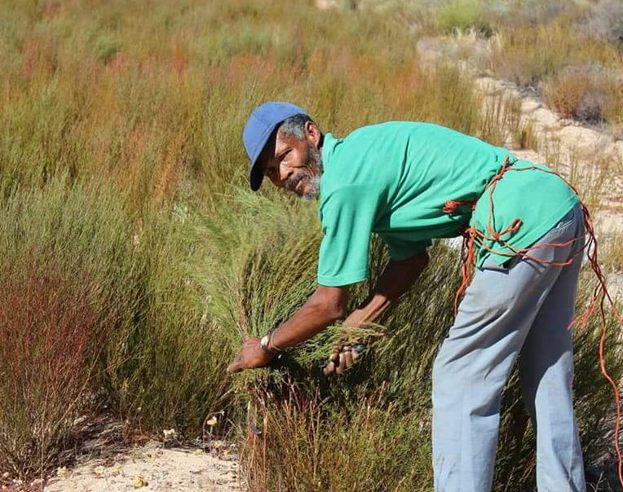
What does “sustainability” mean for Fynbos sectors?
Source product with tea producers who adhere to best practice
Support producers in their efforts to fulfill certification obligations and best practice
Become familiar with the sector as a combination of people, plants and place
Notes:
To change or delete the Faculty Name, go to:
View > Slide Master
Edit the text on the very top slide and close the Slide Master by clicking on the X icon “Close Master”.
Delete the slides or ghost placeholders you do not wish to include in your presentation.

Slide 9
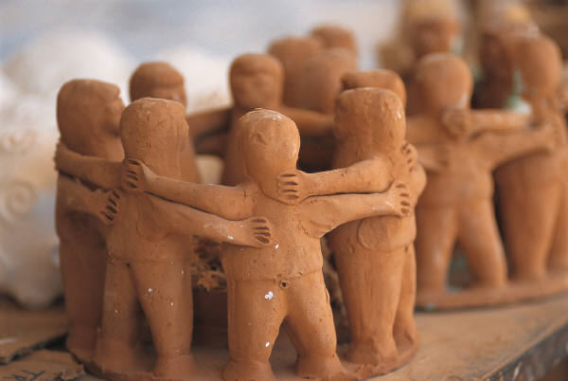
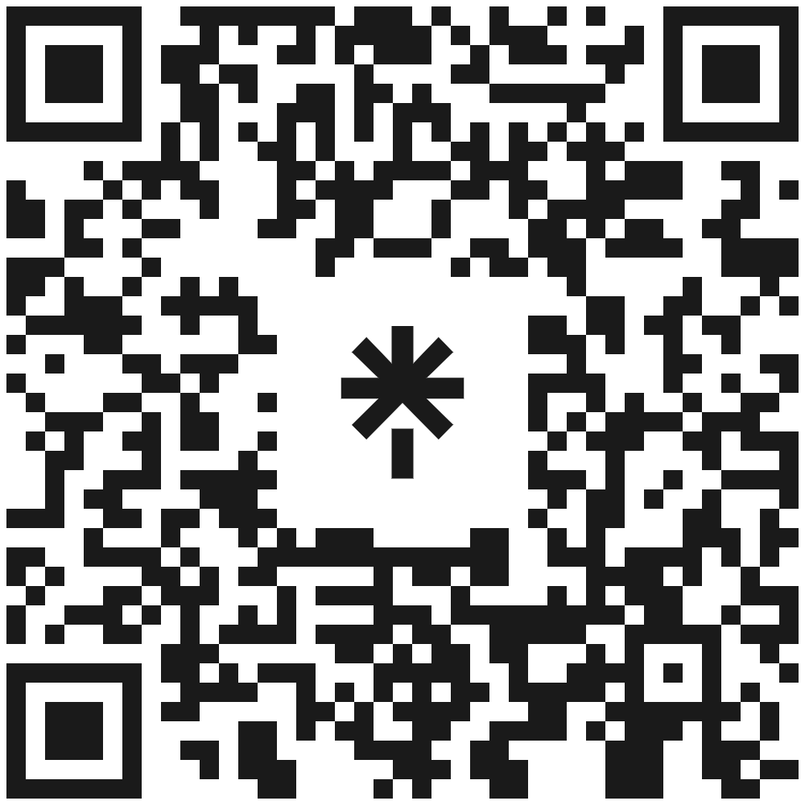
Dankie. Thank you. Nkosi.
Dr Rhoda Malgas
Department of Conservation Ecology and Entomology
Stellenbosch University
South Africa
rmalgas@sun.ac.za
0826722750

